Slide 1
Discrete-Time Fourier Series
Lecture 27

Slide 2



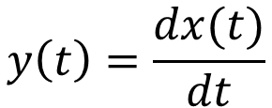
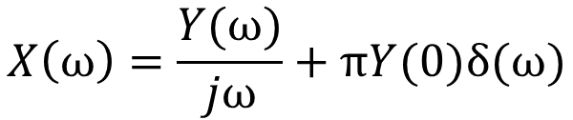
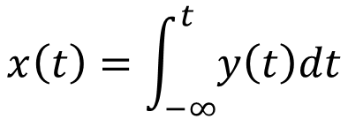
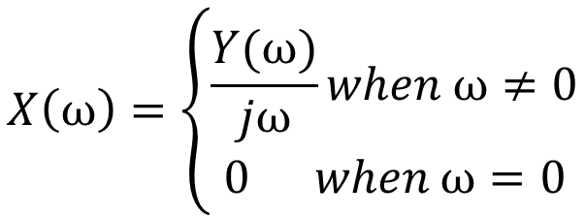
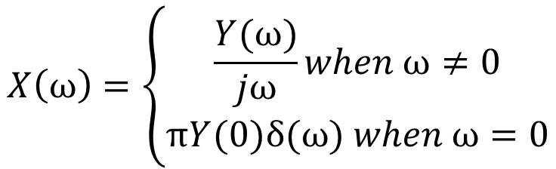
Caution in Differencing/Differentiation
$$y\left(t\right)=\frac{dx(t)}{dt}$$
$$x\left(t\right)=\int_{−∞}^{t}{y\left(t\right)dt}$$
$$X\left(ω\right)=\frac{Y(ω)}{jω}+πY(0)δ(ω)$$
$$Y\left(ω\right)=jωX(ω)$$
$$X\left(ω\right)=\left\{\begin{aligned}\frac{Y(ω)}{jω}when ω≠0 \\ 0 when ω=0\end{aligned}\right.$$
$$X\left(ω\right)=\left\{\begin{aligned}\frac{Y(ω)}{jω}when ω≠0 \\ πY(0)δ(ω) when ω=0\end{aligned}\right.$$
When $X\left(0\right)=\int_{−∞}^{∞}{x(t)}dt$ is finite
When $X\left(0\right)=\int_{−∞}^{∞}{x(t)}dt$ is infinite

Slide 3
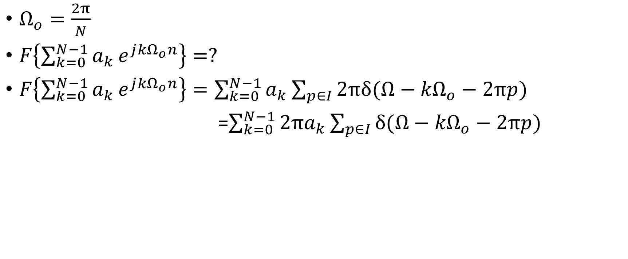
Example
$Ω_{o}=\frac{2π}{N}$
$F\left\{{\sum_{k=0}^{N−1}{a_{k}}e}^{j{kΩ}_{o}n}\right\}=?$
$F\left\{{\sum_{k=0}^{N−1}{a_{k}}e}^{j{kΩ}_{o}n}\right\}=\sum_{k=0}^{N−1}{a_{k}\sum_{p∈I}{2πδ(Ω−{kΩ}_{o}−2πp)}}$
=$\sum_{k=0}^{N−1}{{2πa}_{k}\sum_{p∈I}{δ(Ω−{kΩ}_{o}−2πp)}}$

Slide 4
Example
$F\left\{{\sum_{k=0}^{N−1}{a_{k}}e}^{j{kΩ}_{o}n}\right\}$=$\sum_{k=0}^{N−1}{{2πa}_{k}\sum_{p∈I}{δ(Ω−{kΩ}_{o}−2πp)}}$

Slide 5






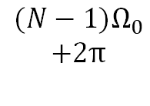












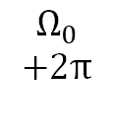


Example
$F\left\{{\sum_{k=0}^{N−1}{a_{k}}e}^{j{kΩ}_{o}n}\right\}$=$\sum_{k=0}^{N−1}{{2πa}_{k}\sum_{p∈I}{δ(Ω−{kΩ}_{o}−2πp)}}$
$$k=$$
$$0$$
$$1$$
$$2$$
$$3$$
$$N−1$$
$$0$$
$$Ω_{0}$$
$${2Ω}_{0}$$
$${3Ω}_{0}$$
$${(N−1)Ω}_{0}$$
$$k=$$
$$N$$
$$N+1$$
$$N+2$$
$$N+3$$
$$2N−1$$
$$2π$$
$$Ω_{0}$$
$$+2π$$
$${2Ω}_{0}$$
$$+2π$$
$$+2π {3Ω}_{0}$$
$${(N−1)Ω}_{0}$$
$$+2π$$

Slide 6
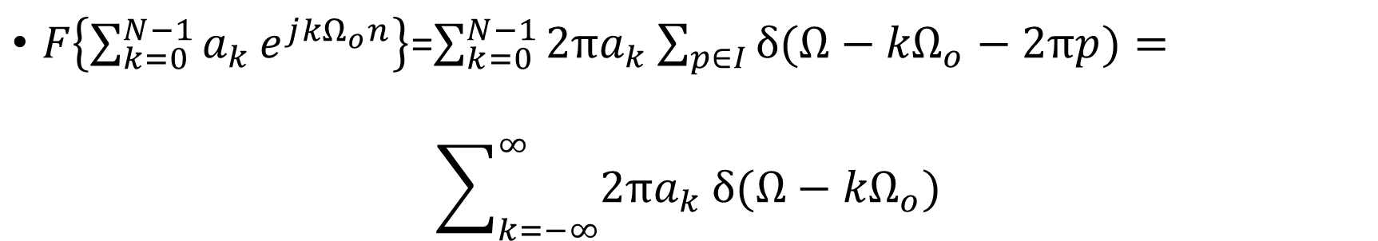
Example
$F\left\{{\sum_{k=0}^{N−1}{a_{k}}e}^{j{kΩ}_{o}n}\right\}$=$\sum_{k=0}^{N−1}{{2πa}_{k}\sum_{p∈I}{δ(Ω−{kΩ}_{o}−2πp)}}=$
$$\sum_{k=−∞}^{∞}{{2πa}_{k}}δ(Ω−{kΩ}_{o})$$

Slide 7
Properties of DTFT
Duality between CTFS and DTFT

Slide 8
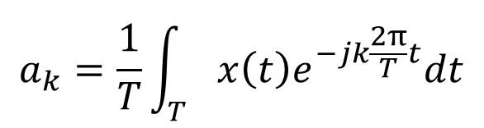
Properties of DTFT
Duality between CTFS and DTFT
$$a_{k}=\frac{1}{T}\int_{T}{x\left(t\right)e^{−jk\frac{2π}{T}t}dt}$$

Slide 9
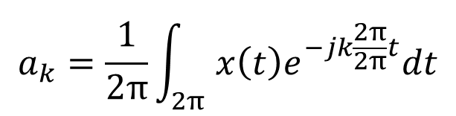
Properties of DTFT
Duality between CTFS and DTFT
$$a_{k}=\frac{1}{T}\int_{T}{x\left(t\right)e^{−jk\frac{2π}{T}t}dt}$$
$$a_{k}=\frac{1}{2π}\int_{2π}{x\left(t\right)e^{−jk\frac{2π}{2π}t}dt}$$

Slide 10

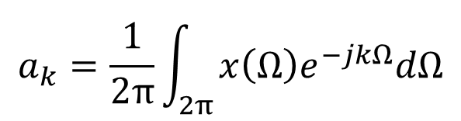
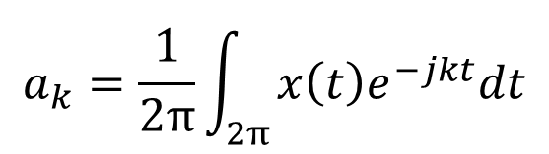
Properties of DTFT
Duality between CTFS and DTFT
$$a_{k}=\frac{1}{T}\int_{T}{x\left(t\right)e^{−jk\frac{2π}{T}t}dt}$$
$$a_{k}=\frac{1}{2π}\int_{2π}{x\left(t\right)e^{−jk\frac{2π}{2π}t}dt}$$
$$a_{k}=\frac{1}{2π}\int_{2π}{x\left(t\right)e^{−jkt}dt}$$
$$t→Ω$$
$$a_{k}=\frac{1}{2π}\int_{2π}{x\left(Ω\right)e^{−jkΩ}dΩ}$$

Slide 11
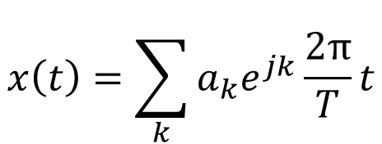
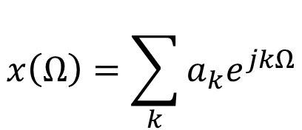
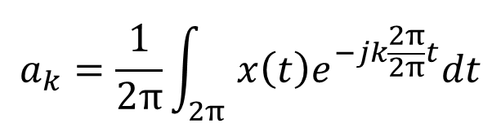
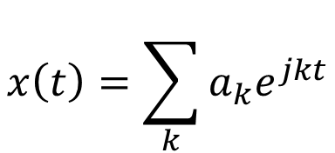
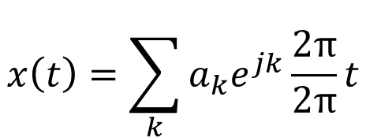
Properties of DTFT
Duality between CTFS and DTFT
$$a_{k}=\frac{1}{T}\int_{T}{x\left(t\right)e^{−jk\frac{2π}{T}t}dt}$$
$$x\left(t\right)=\sum_{k}{a_{k}e^{jk}\frac{2π}{T}t}$$
$$a_{k}=\frac{1}{2π}\int_{2π}{x\left(t\right)e^{−jk\frac{2π}{2π}t}dt}$$
$$x\left(t\right)=\sum_{k}{a_{k}e^{jk}\frac{2π}{2π}t}$$
$$a_{k}=\frac{1}{2π}\int_{2π}{x\left(t\right)e^{−jkt}dt}$$
$$x\left(t\right)=\sum_{k}{a_{k}e^{jkt}}$$
$$t→Ω$$
$$x\left(Ω\right)=\sum_{k}{a_{k}e^{jkΩ}}$$
$$a_{k}=\frac{1}{2π}\int_{2π}{x\left(Ω\right)e^{−jkΩ}dΩ}$$

Slide 12
Discrete-time Fourier Transform

Slide 13
h[n] is periodic

Slide 14
h[n] is periodic

Slide 15
h[n] is periodic

Slide 16
h[n] is periodic

Slide 17
a_{k} from h[n]

Slide 18
a_{k} from h[n]

Slide 19
a_{k} from h[n]

Slide 20
Discrete-time Fourier Series

Slide 21
Think
Consider the following statements:
a) a_{k} are periodic with period N
b) There are only N orthogonal vectors (complex exponential) required to express a periodic discrete time signal.
1) Both a and b are correct | 2) a is true, b is false
3) a is false, b is true | 4) Both a and b are false

Slide 22
Think
Consider the following statements:
a) a_{k} are periodic with period N
b) There are only N orthogonal vectors (complex exponential) required to express a periodic discrete time signal.
1) Both a and b are correct | 2) a is true, b is false
3) a is false, b is true | 4) Both a and b are false

Slide 23
Discrete-time Fourier Series

Slide 24
Discrete-time Fourier Series
Number of distinct complex exponentials

Slide 25
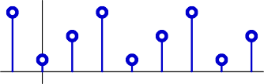
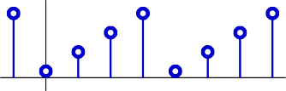
Discrete-time Fourier Series
n
3 samples repeated in time
3 complex exponentials
Example: periodic in N=4
n
4 samples repeated in time
4 complex exponentials

Slide 26
Discrete-time Fourier Series
Strong duality
Finite number of equations and finite number of unknowns
No convergence issues

Slide 27
Example 1
1
Period = N
-N₁
N₁

Slide 28

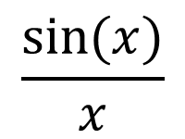
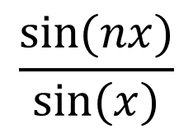
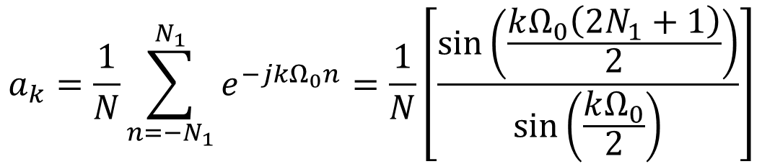
Example 1
1
Period = N
-N₁
N₁
DT
CT
$$a_{k}=\frac{1}{N}\sum_{n=−N_{1}}^{N_{1}}{e^{−jkΩ_{0}n}=\frac{1}{N}\left[\frac{sin\left(\frac{kΩ_{0}\left(2N_{1}+1\right)}{2}\right)}{sin\left(\frac{kΩ_{0}}{2}\right)}\right]}$$
$$\frac{sin⁡(nx)}{sin⁡(x)}$$
$$\frac{sin⁡(x)}{x}$$
$$=$$

Slide 29
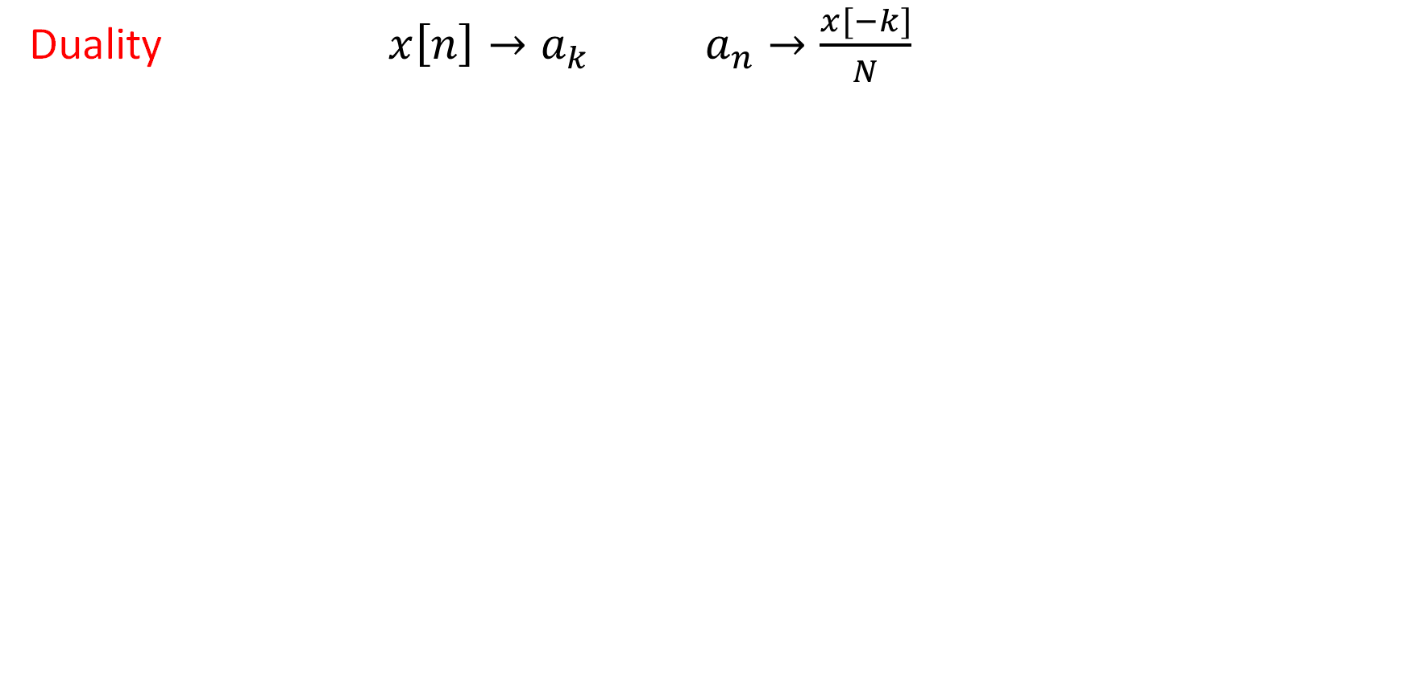
Properties of DTFS
Duality $x\left[n\right]→a_{k} a_{n}→\frac{x[−k]}{N}$

Slide 30
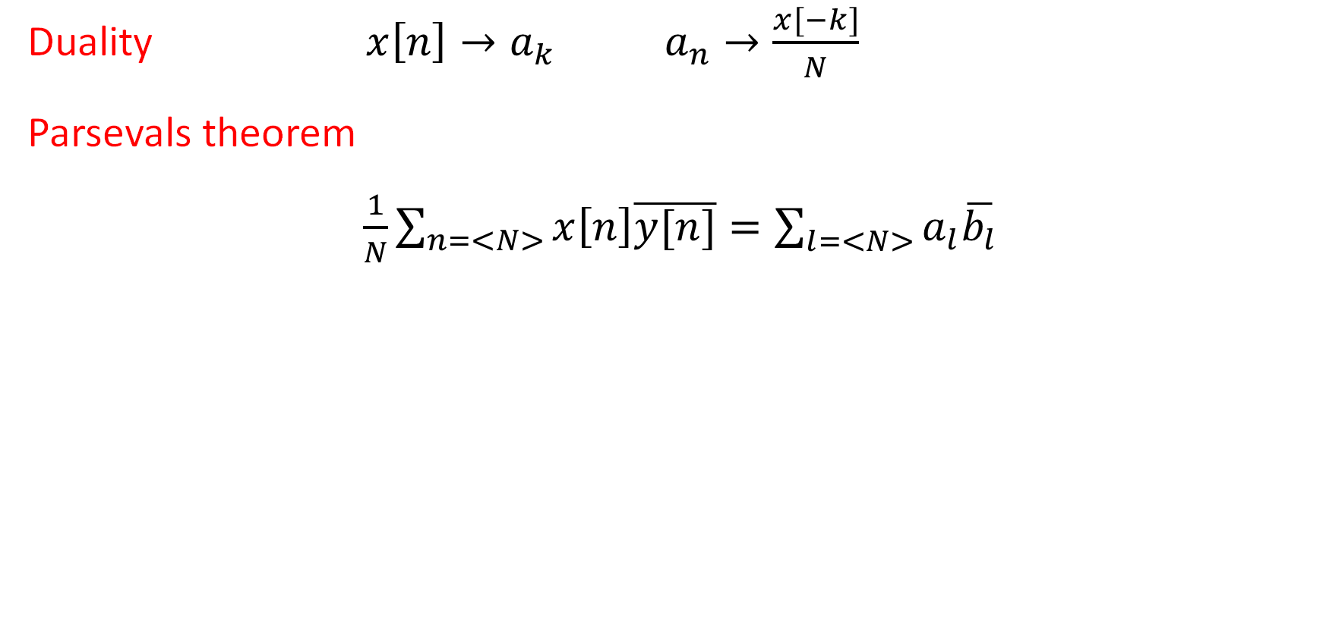
Properties of DTFS
Duality $x\left[n\right]→a_{k} a_{n}→\frac{x[−k]}{N}$
Parsevals theorem
$\frac{1}{N}\sum_{n=<N>}{x\left[n\right]\overline{y[n]}=\sum_{l=<N>}{a_{l}\overline{b_{l}}}}$

Slide 31
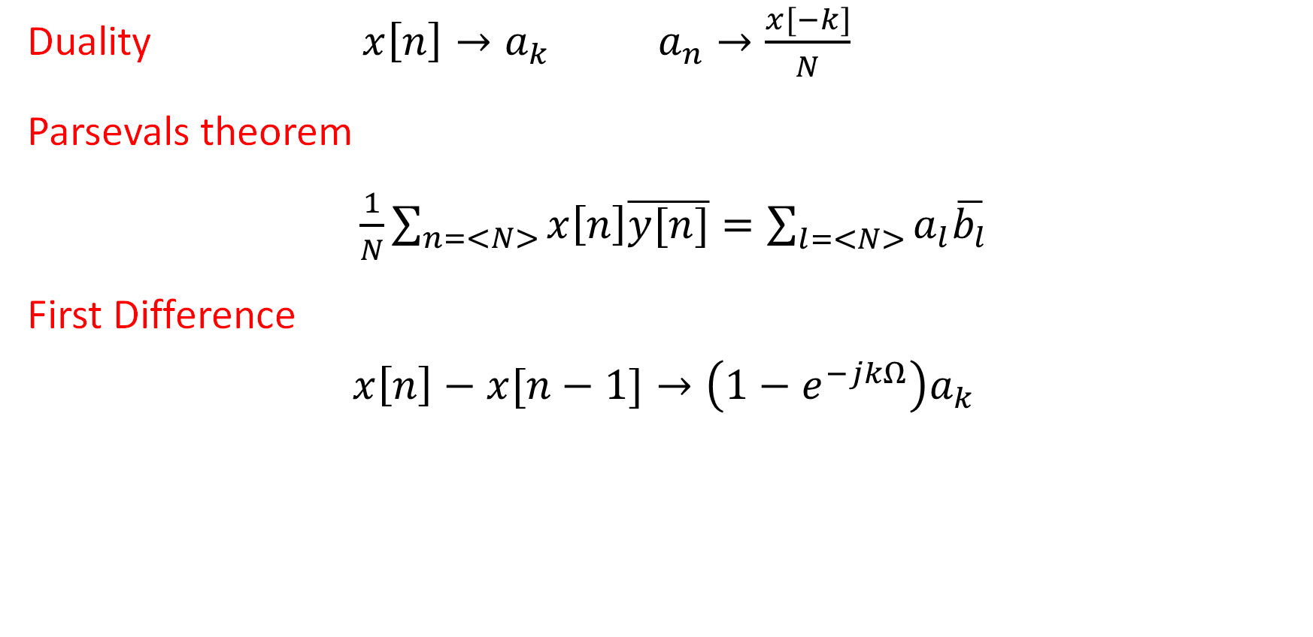
Properties of DTFS
Duality $x\left[n\right]→a_{k} a_{n}→\frac{x[−k]}{N}$
Parsevals theorem
$\frac{1}{N}\sum_{n=<N>}{x\left[n\right]\overline{y[n]}=\sum_{l=<N>}{a_{l}\overline{b_{l}}}}$
First Difference
$$x\left[n\right]−x[n−1]→\left(1−e^{−jkΩ}\right)a_{k}$$

Slide 32
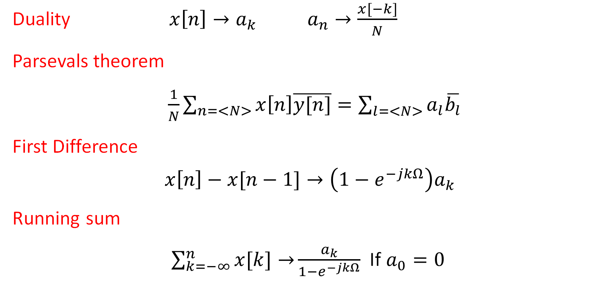
Properties of DTFS
Duality $x\left[n\right]→a_{k} a_{n}→\frac{x[−k]}{N}$
Parsevals theorem
$\frac{1}{N}\sum_{n=<N>}{x\left[n\right]\overline{y[n]}=\sum_{l=<N>}{a_{l}\overline{b_{l}}}}$
First Difference
$$x\left[n\right]−x[n−1]→\left(1−e^{−jkΩ}\right)a_{k}$$
Running sum
$\sum_{k=−∞}^{n}{x[k]→}\frac{a_{k}}{1−e^{−jkΩ}}$ If $a_{0}=0$

Slide 33
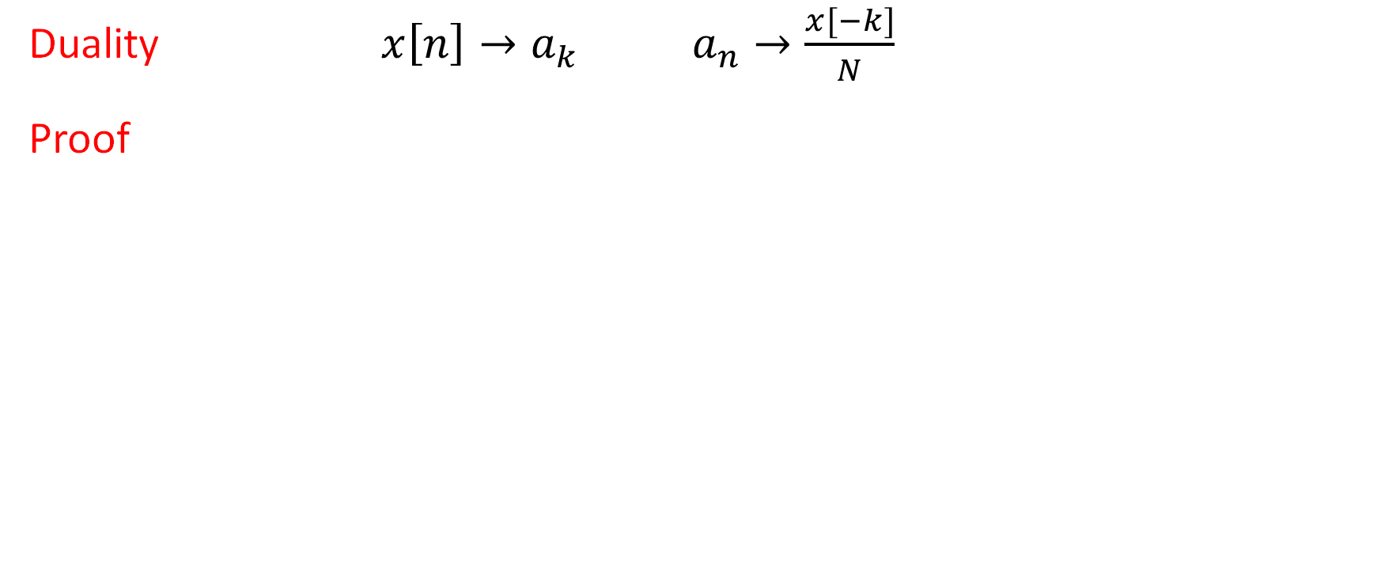
Properties of DTFS
Duality $x\left[n\right]→a_{k} a_{n}→\frac{x[−k]}{N}$
Proof

Slide 34
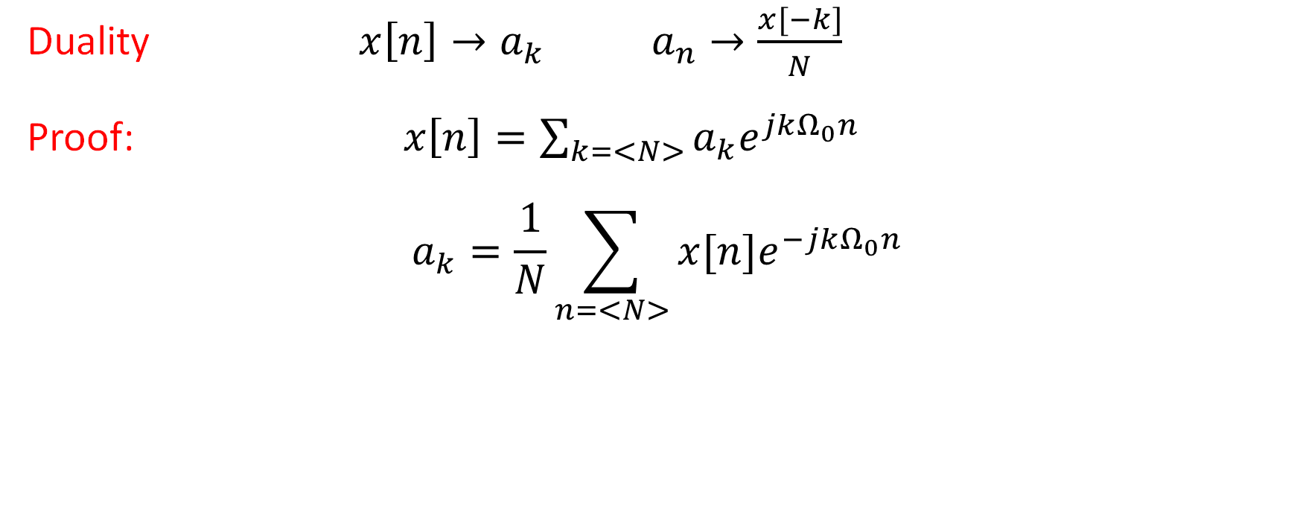
Properties of DTFS
Duality $x\left[n\right]→a_{k} a_{n}→\frac{x[−k]}{N}$
Proof: $x\left[n\right]=\sum_{k=<N>}{a_{k}e^{jkΩ_{0}n}}$
$$a_{k}=\frac{1}{N}\sum_{n=<N>}{x[n]e^{−jkΩ_{0}n}}$$

Slide 35
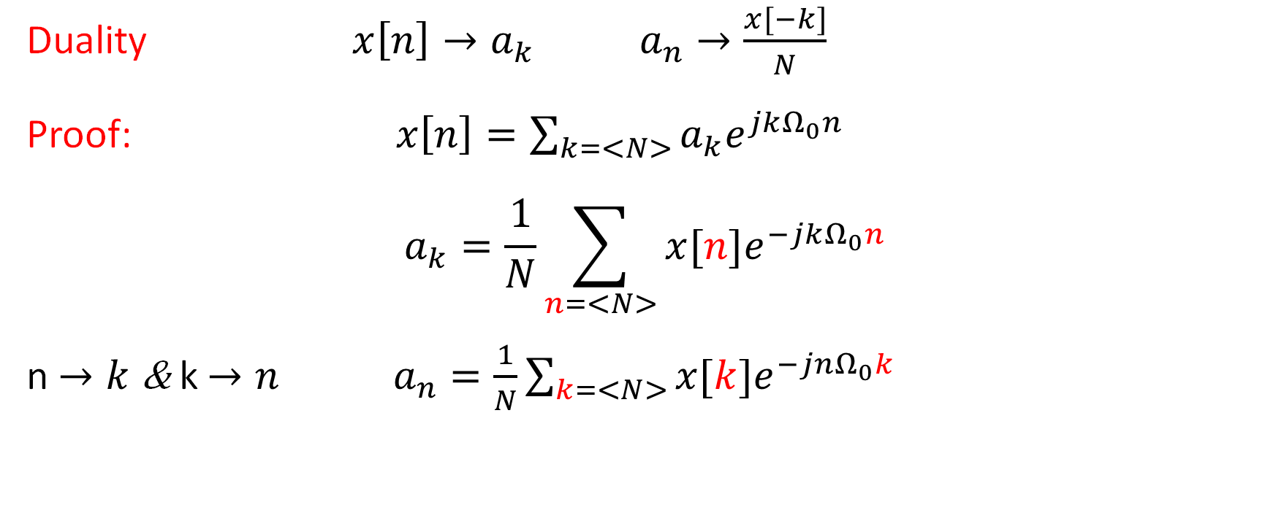
Properties of DTFS
Duality $x\left[n\right]→a_{k} a_{n}→\frac{x[−k]}{N}$
Proof: $x\left[n\right]=\sum_{k=<N>}{a_{k}e^{jkΩ_{0}n}}$
$$a_{k}=\frac{1}{N}\sum_{n=<N>}{x[n]e^{−jkΩ_{0}n}}$$
n $→k$ & k $→n a_{n}=\frac{1}{N}\sum_{k=<N>}{x[k]e^{−jnΩ_{0}k}}$

Slide 36
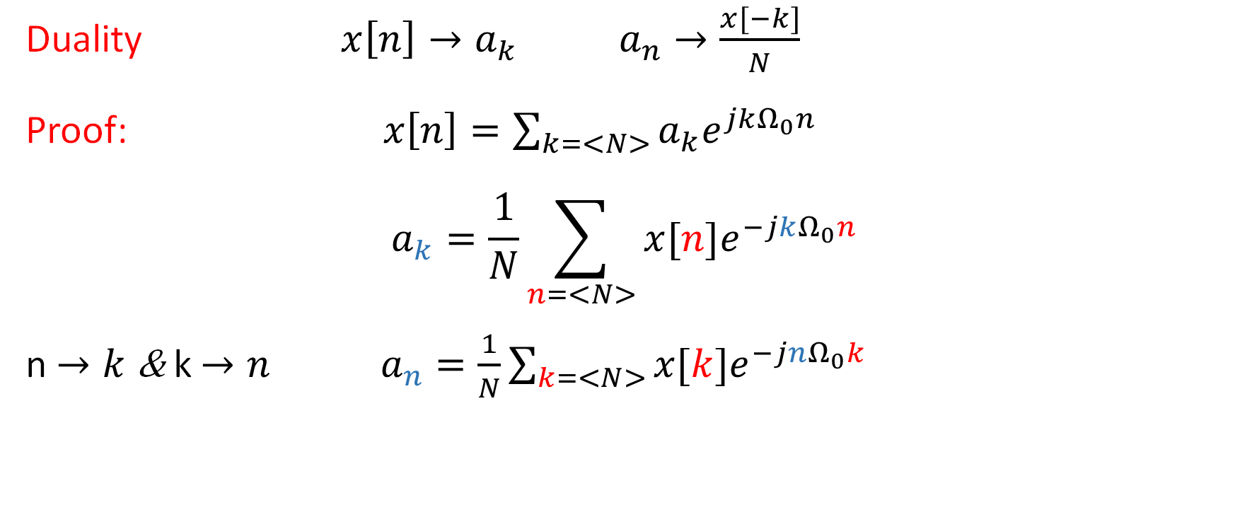
Properties of DTFS
Duality $x\left[n\right]→a_{k} a_{n}→\frac{x[−k]}{N}$
Proof: $x\left[n\right]=\sum_{k=<N>}{a_{k}e^{jkΩ_{0}n}}$
$$a_{k}=\frac{1}{N}\sum_{n=<N>}{x[n]e^{−jkΩ_{0}n}}$$
n $→k$ & k $→n a_{n}=\frac{1}{N}\sum_{k=<N>}{x[k]e^{−jnΩ_{0}k}}$

Slide 37
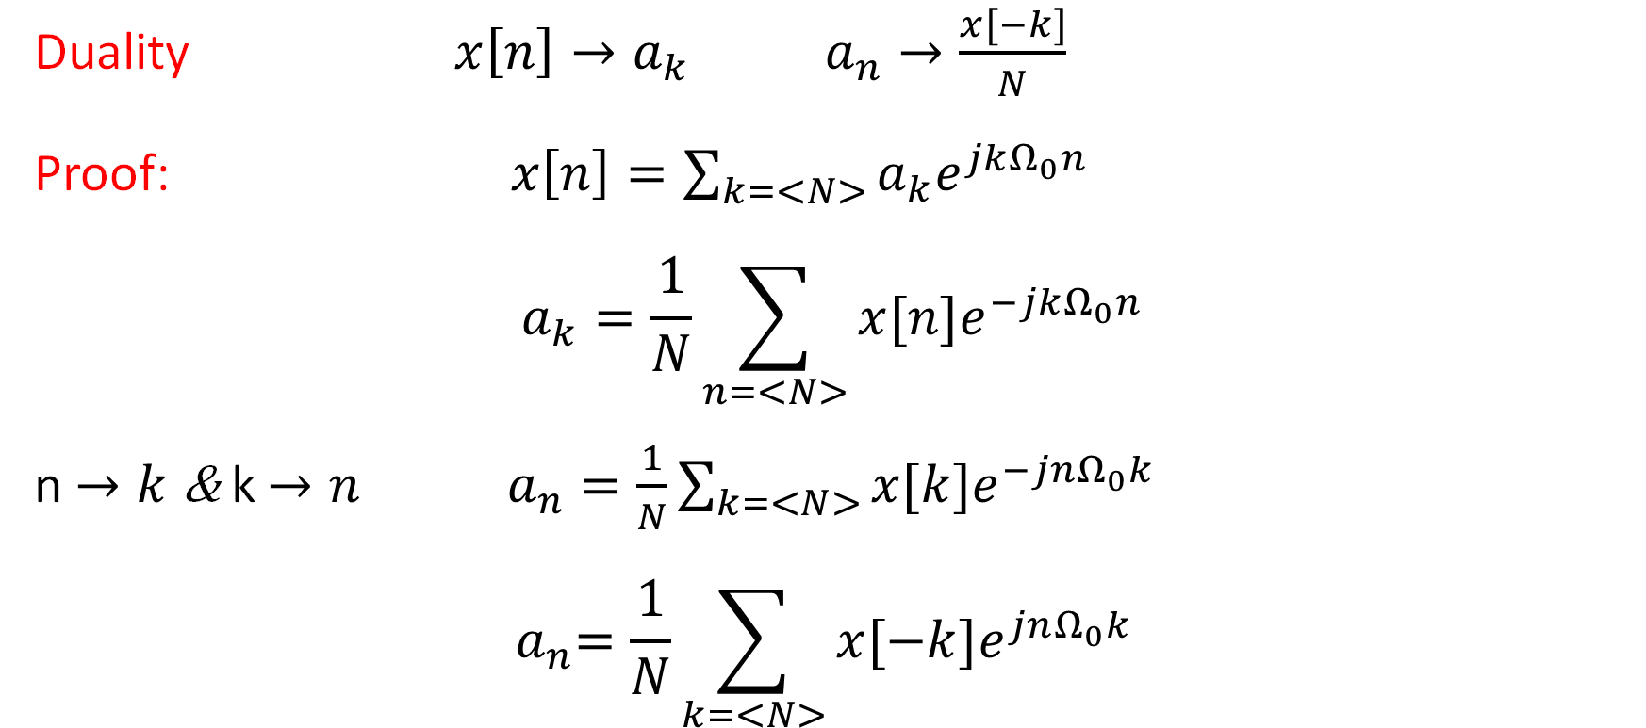
Properties of DTFS
Duality $x\left[n\right]→a_{k} a_{n}→\frac{x[−k]}{N}$
Proof: $x\left[n\right]=\sum_{k=<N>}{a_{k}e^{jkΩ_{0}n}}$
$$a_{k}=\frac{1}{N}\sum_{n=<N>}{x[n]e^{−jkΩ_{0}n}}$$
n $→k$ & k $→n a_{n}=\frac{1}{N}\sum_{k=<N>}{x[k]e^{−jnΩ_{0}k}}$
$${ a}_{n}=\frac{1}{N}\sum_{k=<N>}{x[−k]e^{jnΩ_{0}k}}$$

Slide 38
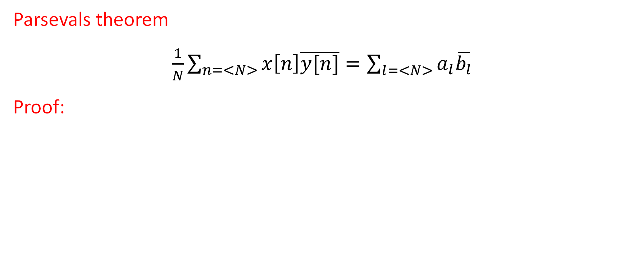
Properties of DTFS
Parsevals theorem
$\frac{1}{N}\sum_{n=<N>}{x\left[n\right]\overline{y[n]}=\sum_{l=<N>}{a_{l}\overline{b_{l}}}}$
Proof:

Slide 39
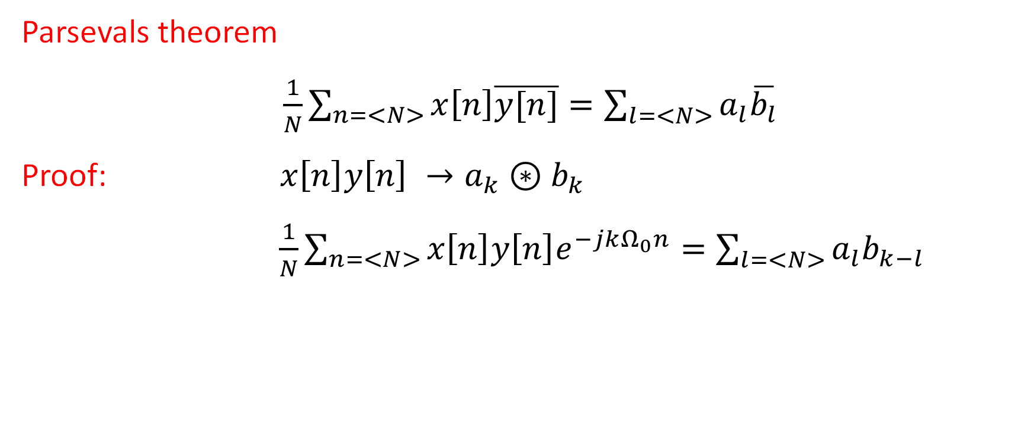
Properties of DTFS
Parsevals theorem
$\frac{1}{N}\sum_{n=<N>}{x\left[n\right]\overline{y[n]}=\sum_{l=<N>}{a_{l}\overline{b_{l}}}}$
Proof: $x\left[n\right]{y\left[n\right] →a_{k}⊛b}_{k}$
$\frac{1}{N}\sum_{n=<N>}{x\left[n\right]{y\left[n\right]e}^{−jkΩ_{0}n}=\sum_{l=<N>}{a_{l}b_{k−l}}}$

Slide 40
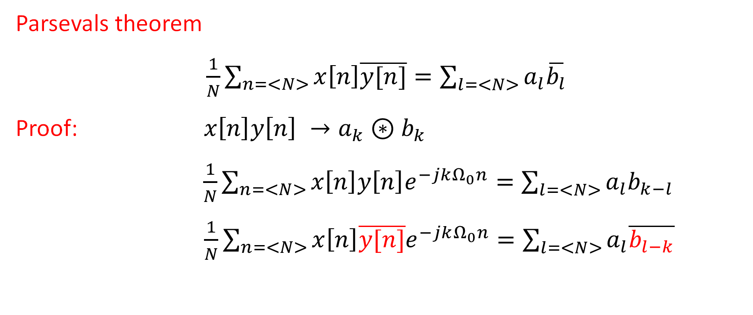
Properties of DTFS
Parsevals theorem
$\frac{1}{N}\sum_{n=<N>}{x\left[n\right]\overline{y[n]}=\sum_{l=<N>}{a_{l}\overline{b_{l}}}}$
Proof: $x\left[n\right]{y\left[n\right] →a_{k}⊛b}_{k}$
$\frac{1}{N}\sum_{n=<N>}{x\left[n\right]{y\left[n\right]e}^{−jkΩ_{0}n}=\sum_{l=<N>}{a_{l}b_{k−l}}}$
$\frac{1}{N}\sum_{n=<N>}{x\left[n\right]{\overline{y[n]}e}^{−jkΩ_{0}n}=\sum_{l=<N>}{a_{l}\overline{b_{l−k}}}}$

Slide 41
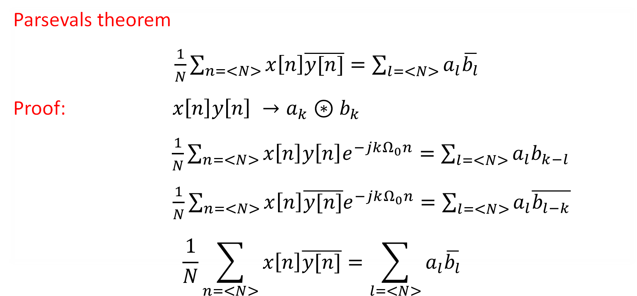
Properties of DTFS
Parsevals theorem
$\frac{1}{N}\sum_{n=<N>}{x\left[n\right]\overline{y[n]}=\sum_{l=<N>}{a_{l}\overline{b_{l}}}}$
Proof: $x\left[n\right]{y\left[n\right] →a_{k}⊛b}_{k}$
$\frac{1}{N}\sum_{n=<N>}{x\left[n\right]{y\left[n\right]e}^{−jkΩ_{0}n}=\sum_{l=<N>}{a_{l}b_{k−l}}}$
$\frac{1}{N}\sum_{n=<N>}{x\left[n\right]{\overline{y[n]}e}^{−jkΩ_{0}n}=\sum_{l=<N>}{a_{l}\overline{b_{l−k}}}}$
$$\frac{1}{N}\sum_{n=<N>}{x\left[n\right]\overline{y[n]}=\sum_{l=<N>}{a_{l}\overline{b_{l}}}}$$

Slide 42
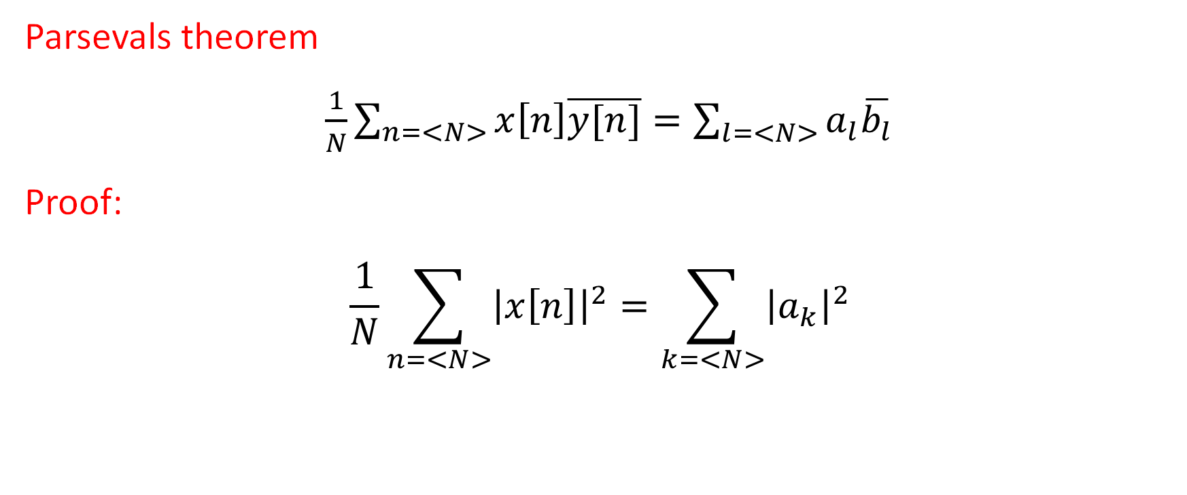
Properties of DTFS
Parsevals theorem
$\frac{1}{N}\sum_{n=<N>}{x\left[n\right]\overline{y[n]}=\sum_{l=<N>}{a_{l}\overline{b_{l}}}}$
Proof:
$$\frac{1}{N}\sum_{n=<N>}{{\left|x\left[n\right]\right|}^{2}=\sum_{k=<N>}{{\left|a_{k}\right|}^{2}}}$$

Slide 43
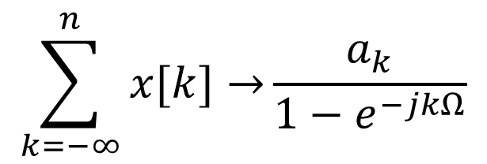

Properties of DTFS
First difference
Running sum
$$x\left[n\right]−x[n−1]→\left(1−e^{−jkΩ}\right)a_{k}$$
$$\sum_{k=−∞}^{n}{x[k]→}\frac{a_{k}}{1−e^{−jkΩ}}$$
If
$$a_{0}=0$$

Slide 44
DTFS (represented by N complex exponentials)

Slide 45
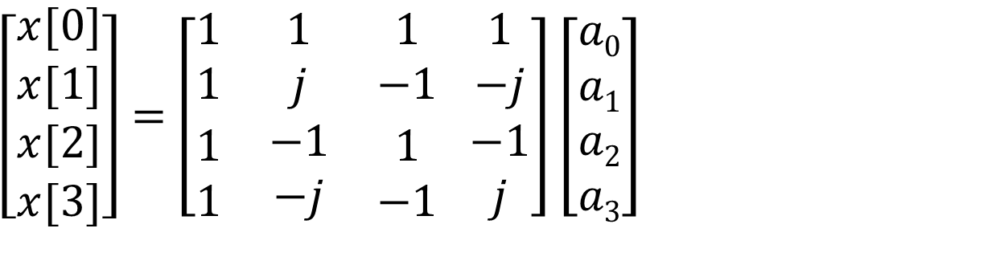
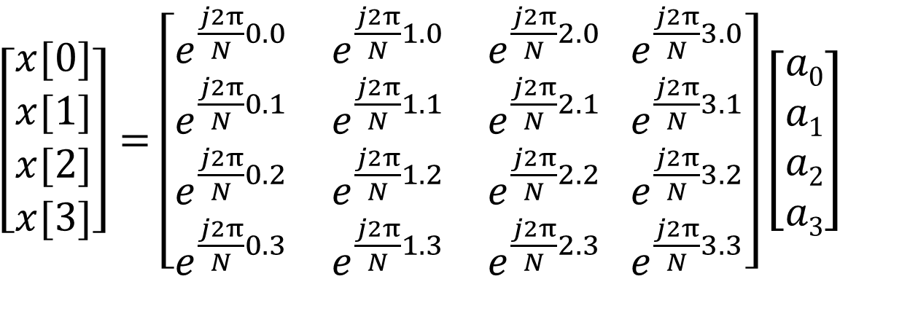
DTFS by Matrix
$\left[\begin{matrix}x[0] \\ x[1] \\ \begin{aligned}x[2] \\ x[3]\end{aligned}\end{matrix}\right]=$ $\left[\begin{matrix}e^{\frac{j2π}{N}0.0} & e^{\frac{j2π}{N}1.0} & e^{\frac{j2π}{N}2.0} \\ e^{\frac{j2π}{N}0.1} & e^{\frac{j2π}{N}1.1} & e^{\frac{j2π}{N}2.1} \\ \begin{aligned}e^{\frac{j2π}{N}0.2} \\ e^{\frac{j2π}{N}0.3}\end{aligned} & \begin{aligned}e^{\frac{j2π}{N}1.2} \\ e^{\frac{j2π}{N}1.3}\end{aligned} & \begin{aligned}e^{\frac{j2π}{N}2.2} \\ e^{\frac{j2π}{N}2.3}\end{aligned}\end{matrix} \begin{matrix}e^{\frac{j2π}{N}3.0} \\ e^{\frac{j2π}{N}3.1} \\ \begin{aligned}e^{\frac{j2π}{N}3.2} \\ e^{\frac{j2π}{N}3.3}\end{aligned}\end{matrix}\right]\left[\begin{aligned}a0 \\ a1 \\ a2 \\ a3\end{aligned}\right]$
$\left[\begin{matrix}x[0] \\ x[1] \\ \begin{aligned}x[2] \\ x[3]\end{aligned}\end{matrix}\right]=$ $\left[\begin{matrix}1 & 1 & 1 \\ 1 & j & −1 \\ \begin{aligned}1 \\ 1\end{aligned} & \begin{aligned}−1 \\ −j\end{aligned} & \begin{aligned}1 \\ −1\end{aligned}\end{matrix} \begin{matrix}1 \\ −j \\ \begin{aligned}−1 \\ j\end{aligned}\end{matrix}\right]\left[\begin{aligned}a0 \\ a1 \\ a2 \\ a3\end{aligned}\right]$

Slide 46
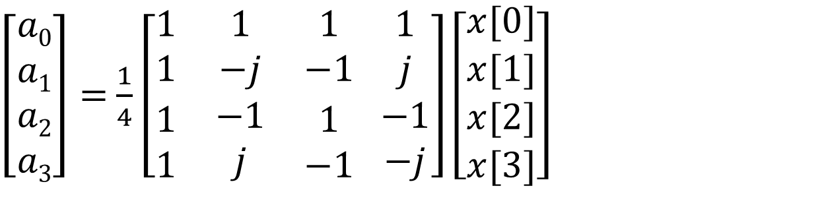
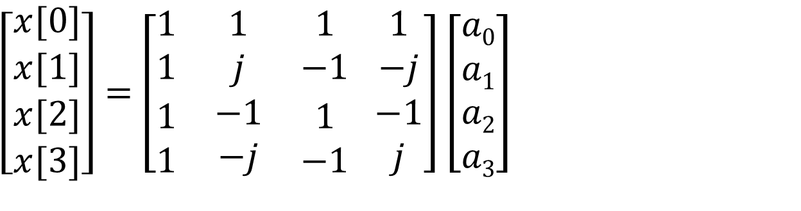
DTFS by Matrix
$\left[\begin{matrix}x[0] \\ x[1] \\ \begin{aligned}x[2] \\ x[3]\end{aligned}\end{matrix}\right]=$ $\left[\begin{matrix}1 & 1 & 1 \\ 1 & j & −1 \\ \begin{aligned}1 \\ 1\end{aligned} & \begin{aligned}−1 \\ −j\end{aligned} & \begin{aligned}1 \\ −1\end{aligned}\end{matrix} \begin{matrix}1 \\ −j \\ \begin{aligned}−1 \\ j\end{aligned}\end{matrix}\right]\left[\begin{aligned}a0 \\ a1 \\ a2 \\ a3\end{aligned}\right]$
Matrices are inverse of each other
$\left[\begin{aligned}a0 \\ a1 \\ a2 \\ a3\end{aligned}\right]=$ $\frac{1}{4}\left[\begin{matrix}1 & 1 & 1 \\ 1 & −j & −1 \\ \begin{aligned}1 \\ 1\end{aligned} & \begin{aligned}−1 \\ j\end{aligned} & \begin{aligned}1 \\ −1\end{aligned}\end{matrix} \begin{matrix}1 \\ j \\ \begin{aligned}−1 \\ −j\end{aligned}\end{matrix}\right]\left[\begin{matrix}x[0] \\ x[1] \\ \begin{aligned}x[2] \\ x[3]\end{aligned}\end{matrix}\right]$
Number of operations increases as N²

